Slide 1
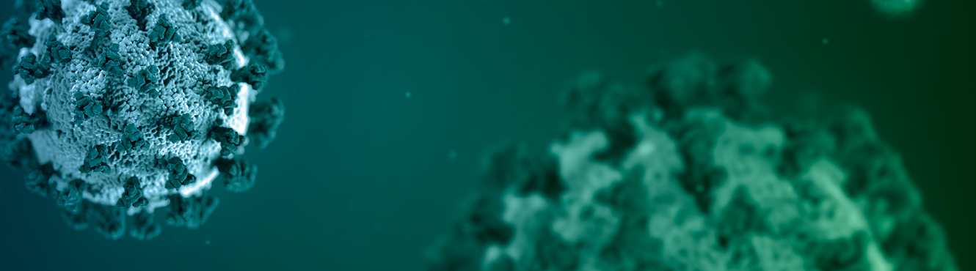
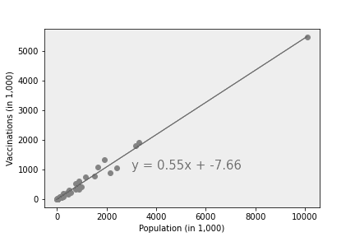
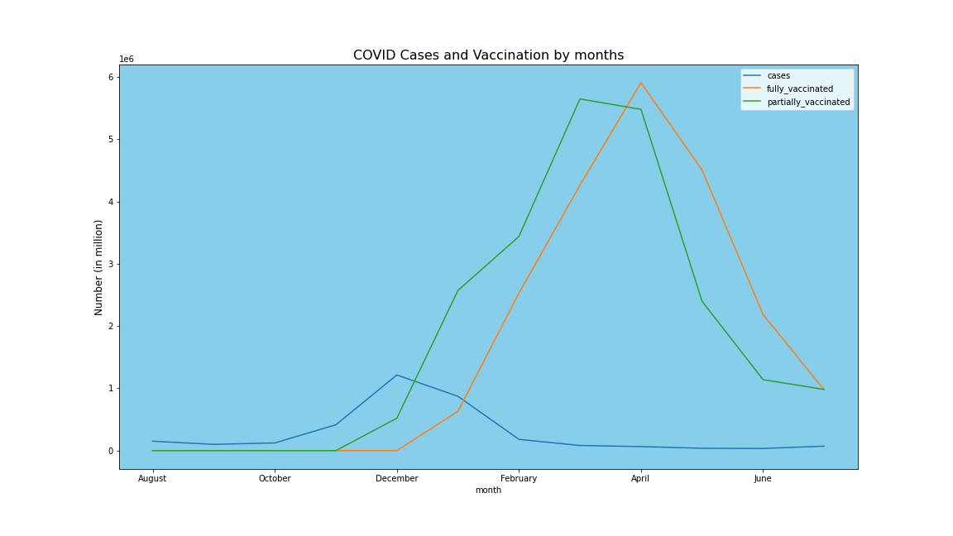
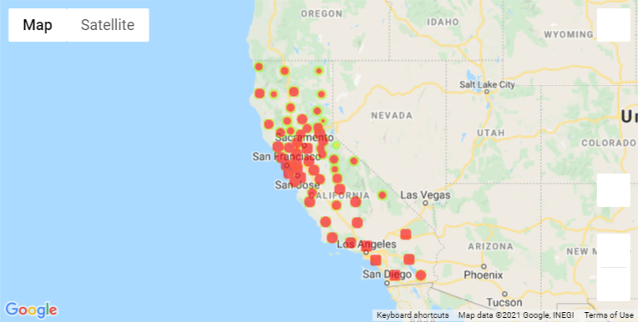
COVID-19 Vaccination California
Team members:
- Tikaram Subedy
- Kristian Hamilton
- David Koski

Slide 2

How strong is the correlation between cases/deaths, and vaccination rates?
My intention when going through this data was to find the strength of the correlation between COVID cases and vaccination rates as well as COVID deaths and vaccination rates. My hypothesis was that there is a high level of correlation between these factors. As one would expect, the statistics show this hypothesis was correct. However, I wanted to try and provide an independent confirmation of this hypothesis, since many of the unvaccinated do not believe the information they get from what they consider “mainstream media”.

Slide 3
CDC
I downloaded all of the information on COVID cases from the CDC website, and then got to work cleaning it.

Slide 4
USAFacts.org
I found the data on COVID deaths in California counties from USAFacts.org. I discovered this site after seeing that they were referenced as a trusted data source in an NPR (National Public Radio) article I was reading.

Slide 5
Data Cleanup David
Describe the data exploration and cleanup process

Slide 6
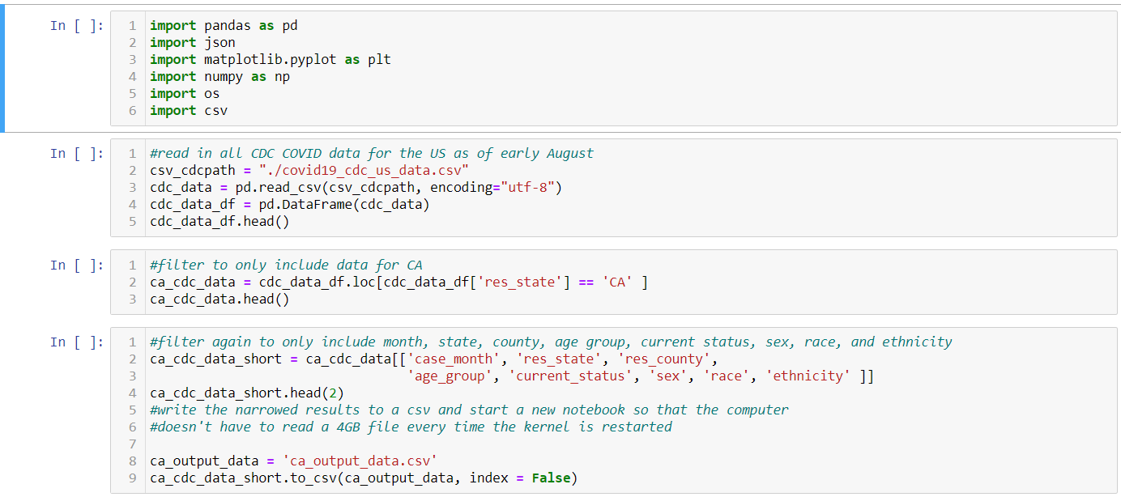
CDC Cleaning

Slide 7
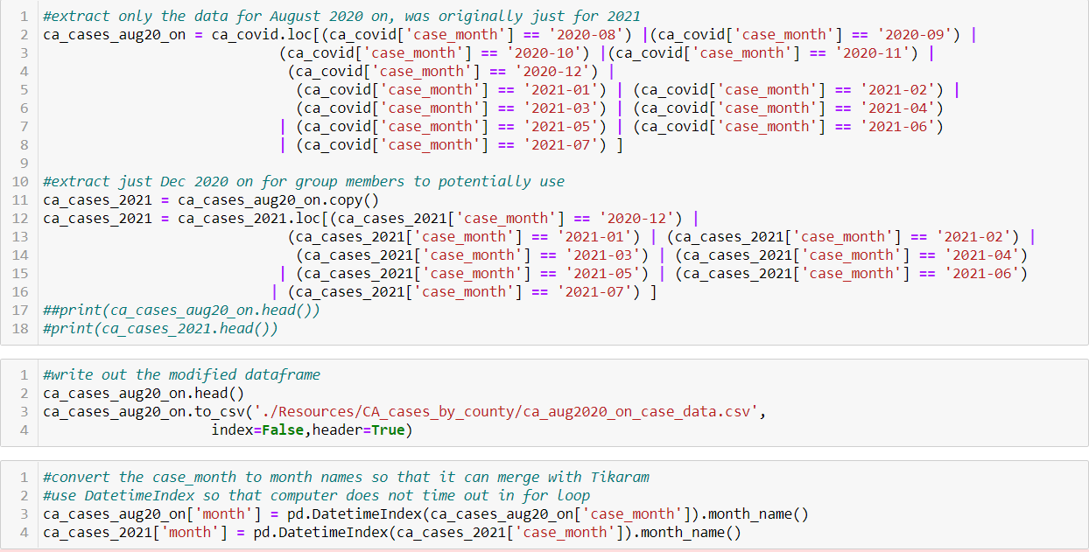
CA CDC Data Cleaning

Slide 8
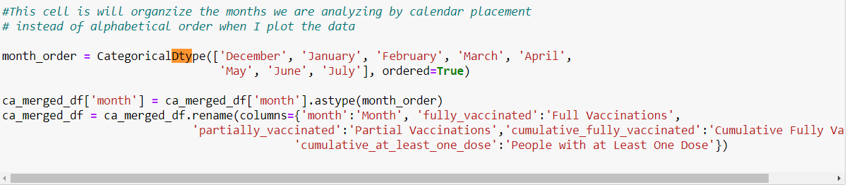
CategoricalDtype Sorting

Slide 9
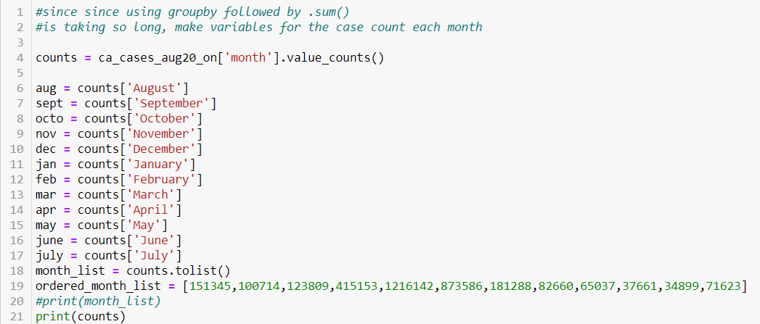
Manually Code Cases per Month

Slide 10
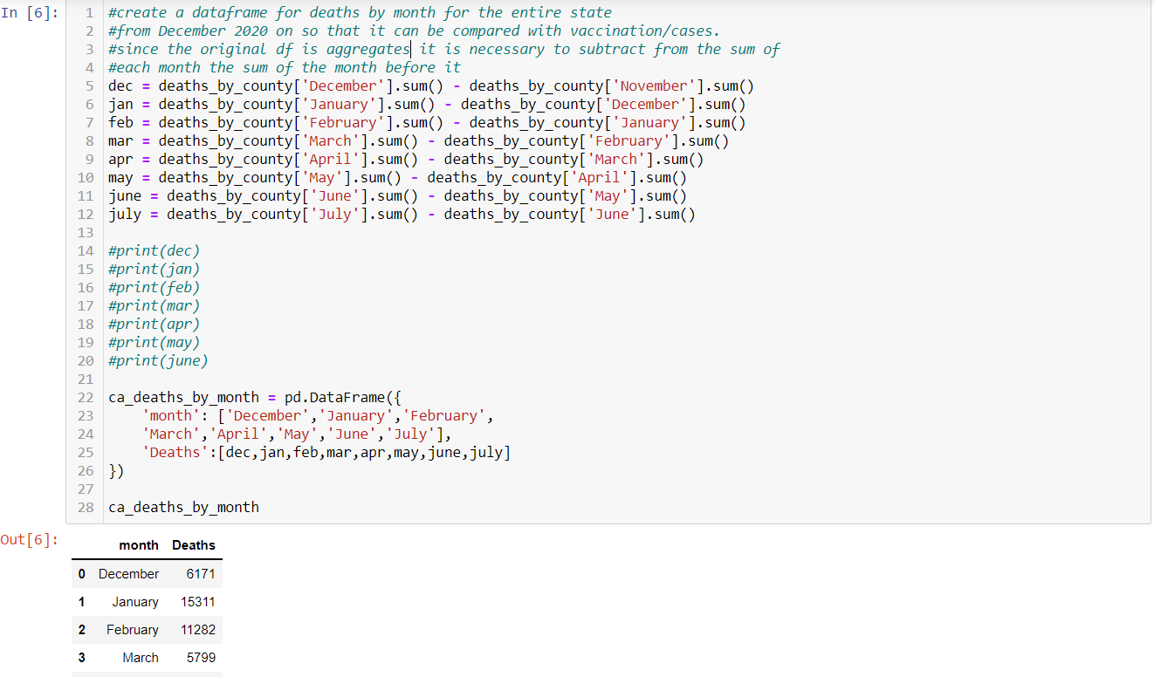
Finding Monthly Death Totals

Slide 11
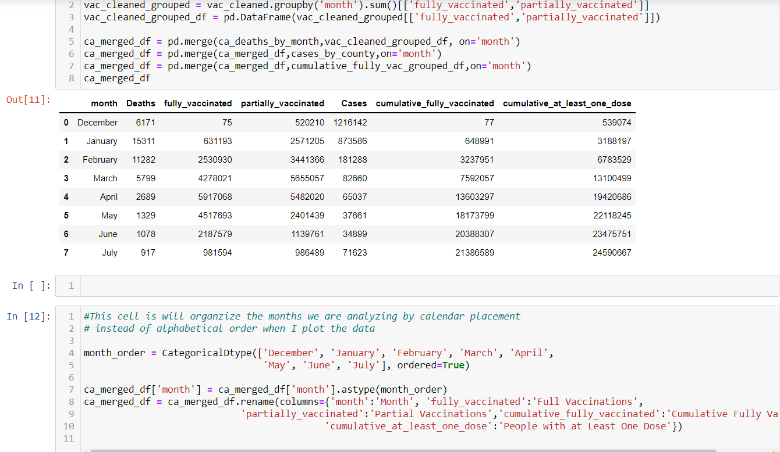
Merging the Cleaned Dataframes

Slide 12
Describe the Analysis Process
Screen shots of code and output
Describe the analysis process

Slide 13
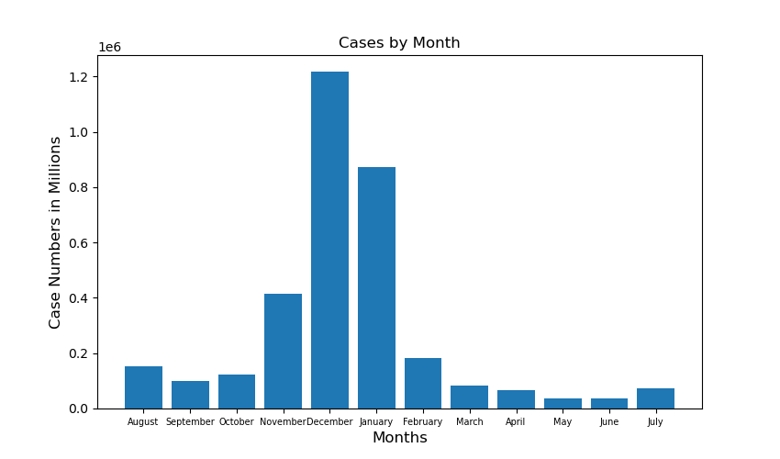
Cases By Month Bar Chart

Slide 14
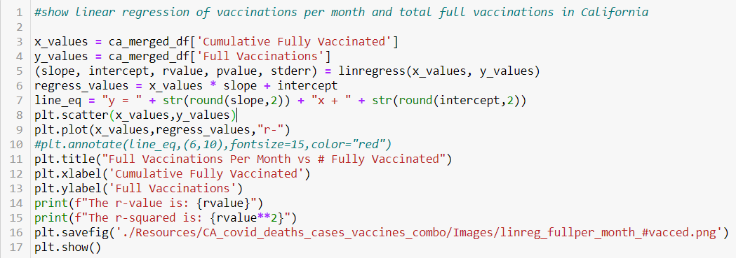
Fully Vaccinated per Month vs. Fully Vaccinated Total Code

Slide 15
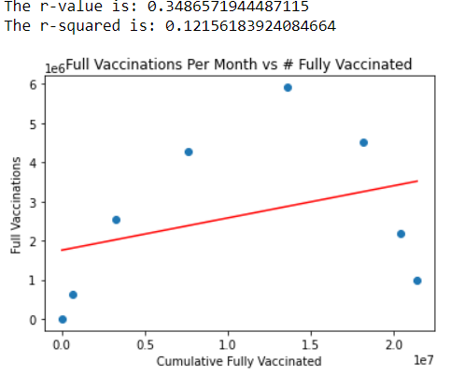
Fully Vaccinated Per Month vs. Fully Vaccinated Total

Slide 16
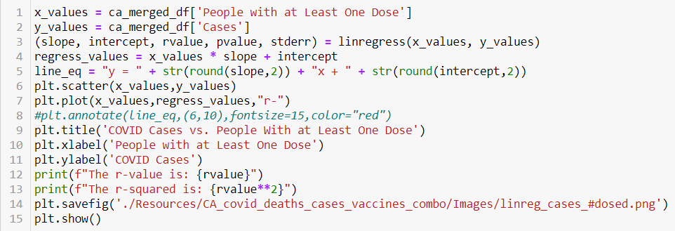
Cases vs. Total With One or More Shots Code

Slide 17
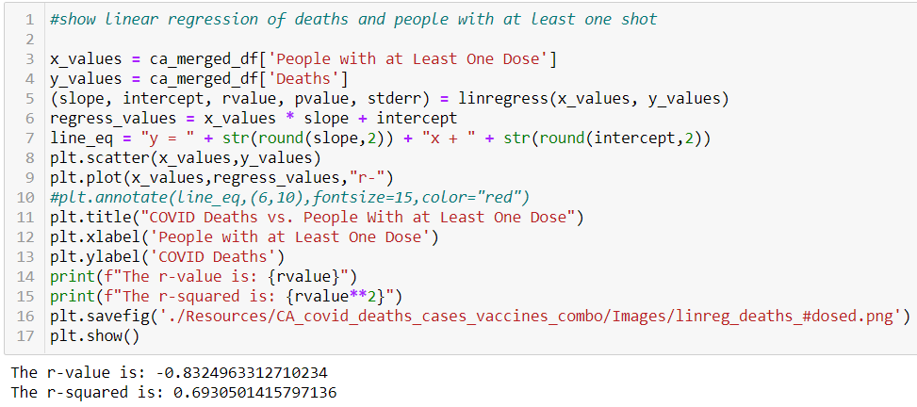
Deaths vs. Total With One or More Shots Code

Slide 18
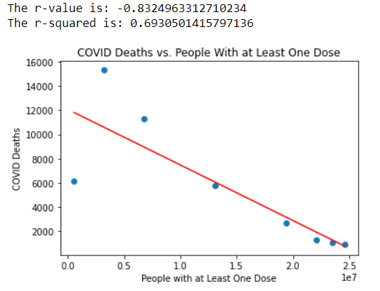
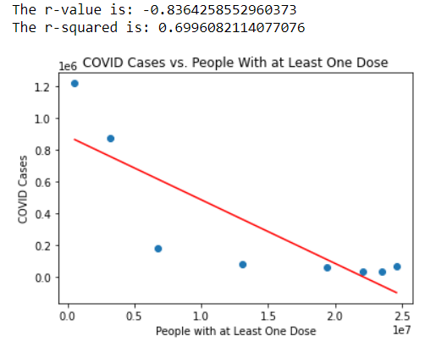
Cases and Deaths vs. Total With One or More Shots

Slide 19
Thank You

